Slide 1



MUSICANO

Slide 2

MUSICANO
Under The Supervision of:-
Mr. Anuj Mangal
(Asst. Professor)
Department of CEA
GLA University, Mathura
Presented By:-
Kratika Agrawal (174200078)
Sagar Gahlot (174200134)
Rishabh Sharma (174200129)
Sachin Saxena (174200132)
Satyam Kushwah (174200142)

Slide 3
Introduction
MUSICANO
Musicano help them to find all notes of every instrument in one place and in additional to it they can create there own band or interact with artist by chatting with them and from this sites teachers can also download notes for their student. This site also include notes with audio and video.

Slide 4
Objective
Decrease human efforts
Valuable Tutorials
Explore skills
Find talent
Save time & money
MUSICANO

Slide 5
MUSICANO
Purpose
The purpose of this site is to stop people for notes struggling and start people learning journey in an efficient manner.
Musicano help in finding the hidden talent of the student and give a path to them to show their talent on an higher level where the value of that talent be examined by the famous music artist.

Slide 6
MUSICANO
Tools & technology
XAMPP 7.3.1
Notepad++
Html 5 & CSS
MySQL 2012
Java Script

Slide 7
MUSICANO
Problem statements
The main problem in everyone’s life is of learning. A person or student can’t get proper notes of ever subject or every course. But here the purpose of this site is to provide –
Proper notes
Knowledge
Experience
Explore skills
related to musical instruments.

Slide 8
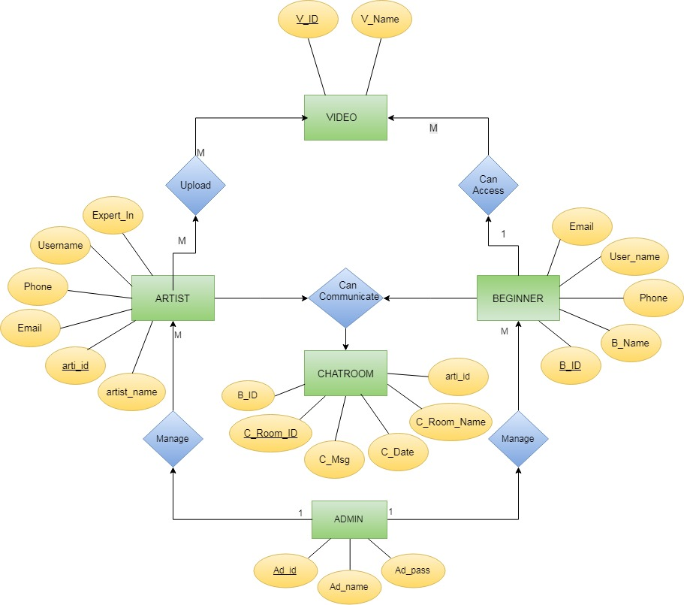
ER diagram
MUSICANO

Slide 9
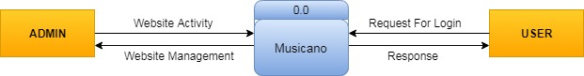
Data flow diagram
MUSICANO
Level 0

Slide 10
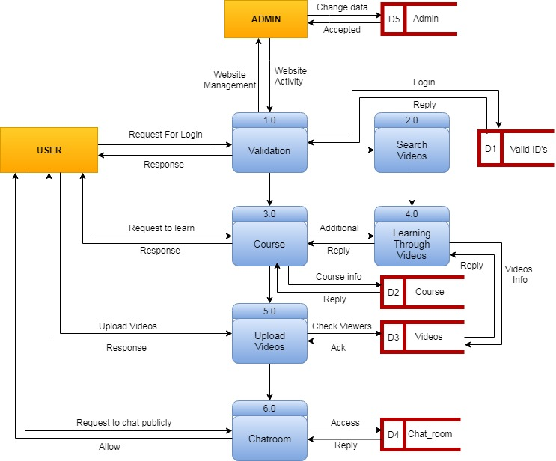
Level 1
MUSICANO

Slide 11
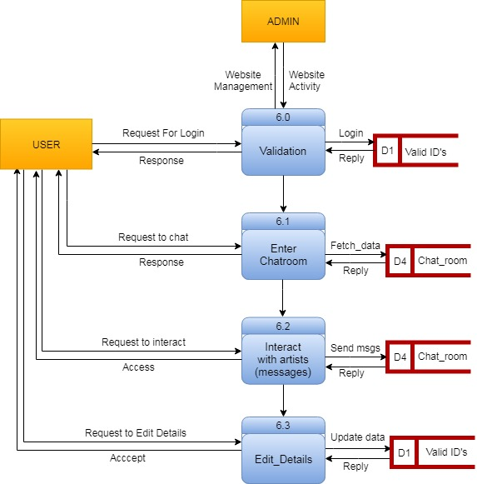
Level 2 Process-6
MUSICANO

Slide 12
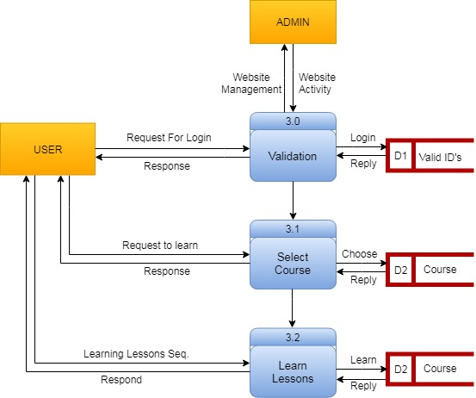
Level 2 Process-3
MUSICANO

Slide 13
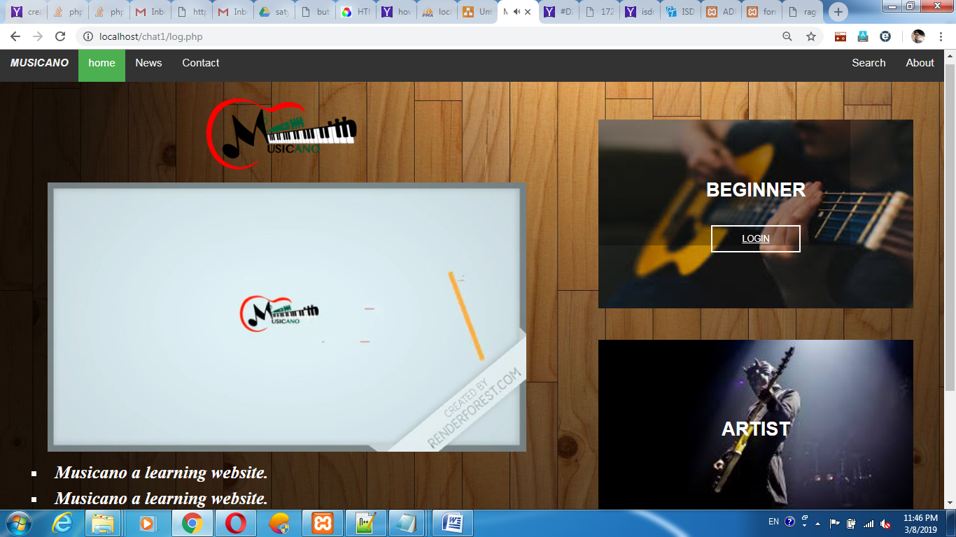
Some Screenshots
MUSICANO

Slide 14
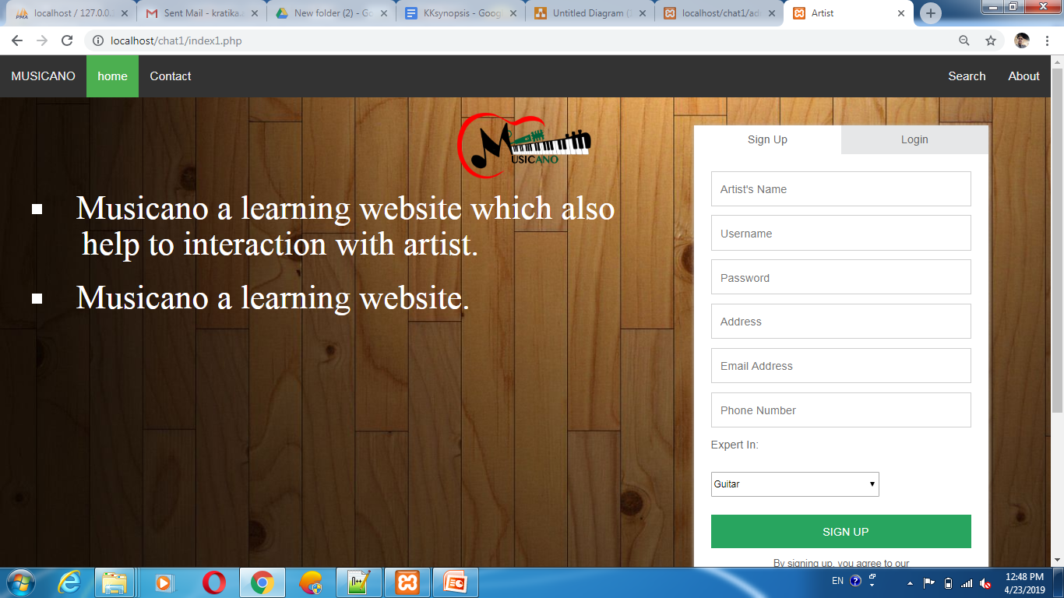
MUSICANO

Slide 15
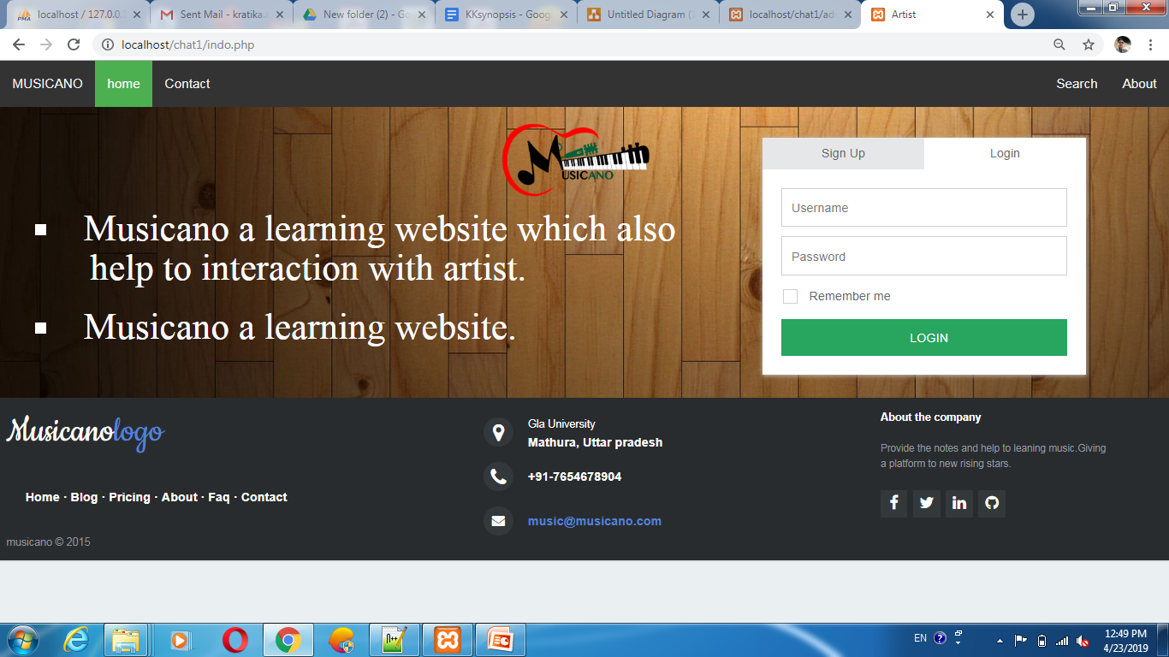

Slide 16
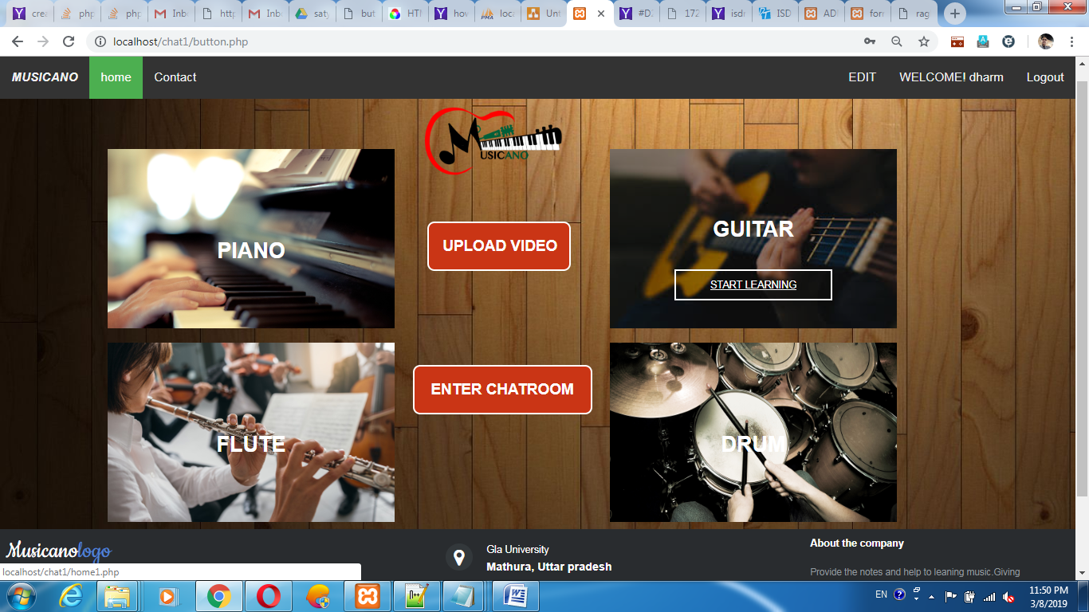

Slide 17
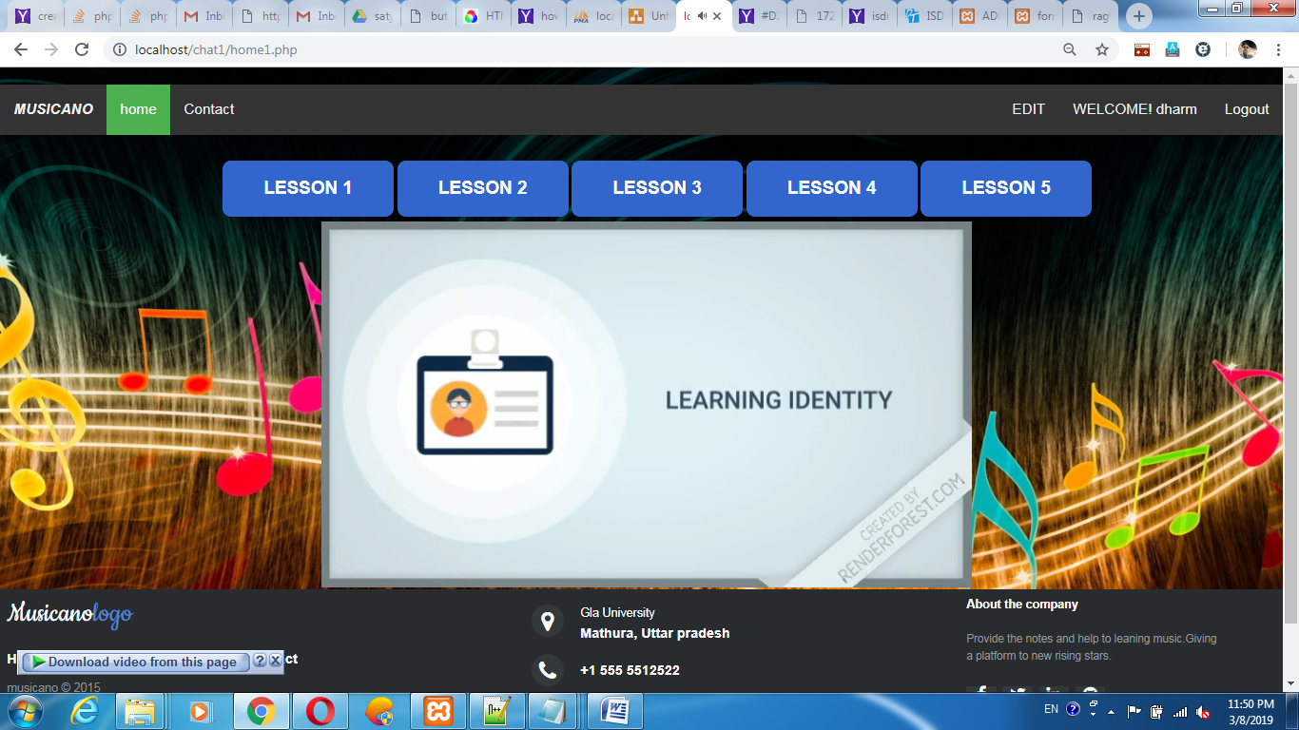

Slide 18
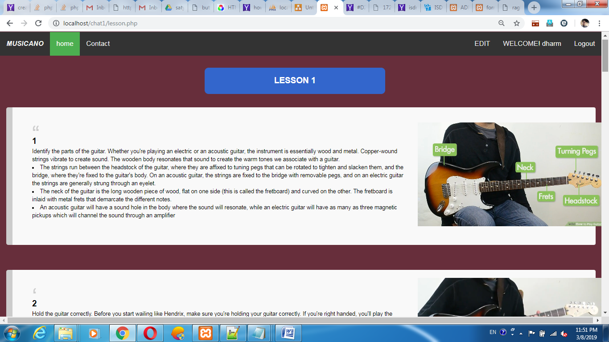

Slide 19
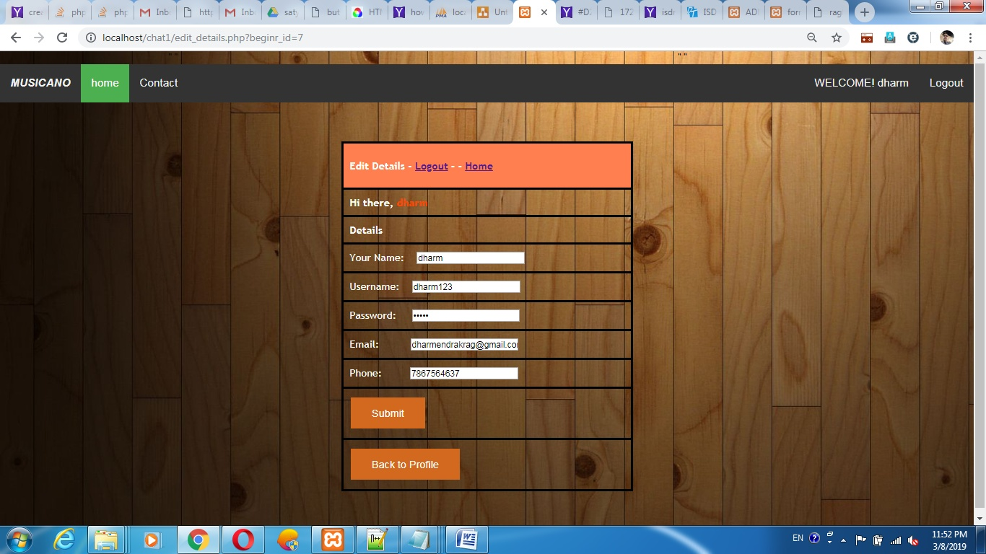

Slide 20
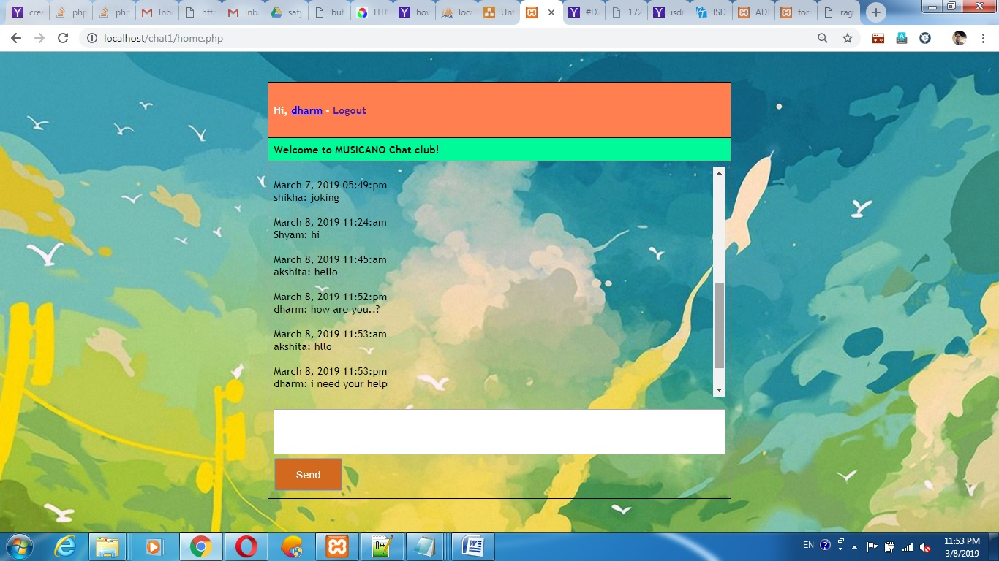

Slide 21
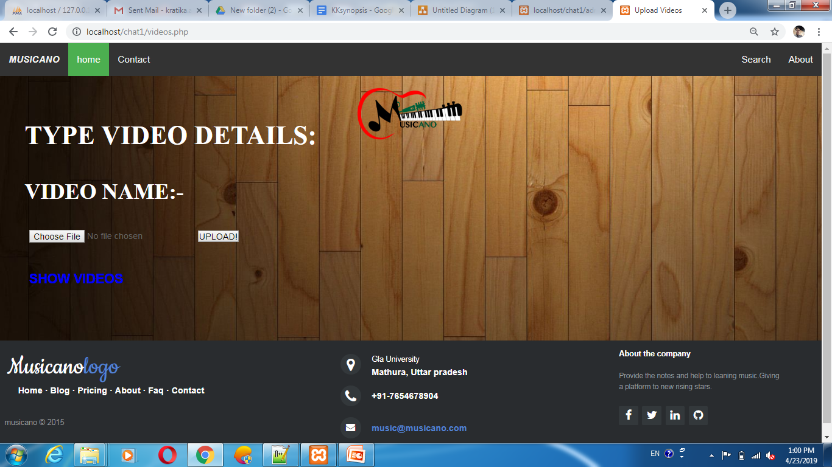

Slide 22
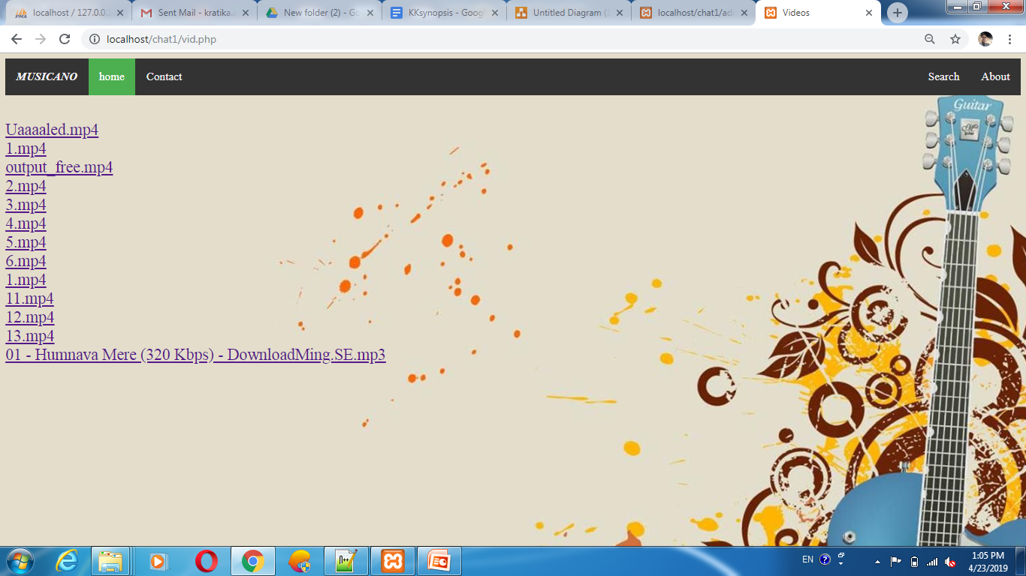

Slide 23
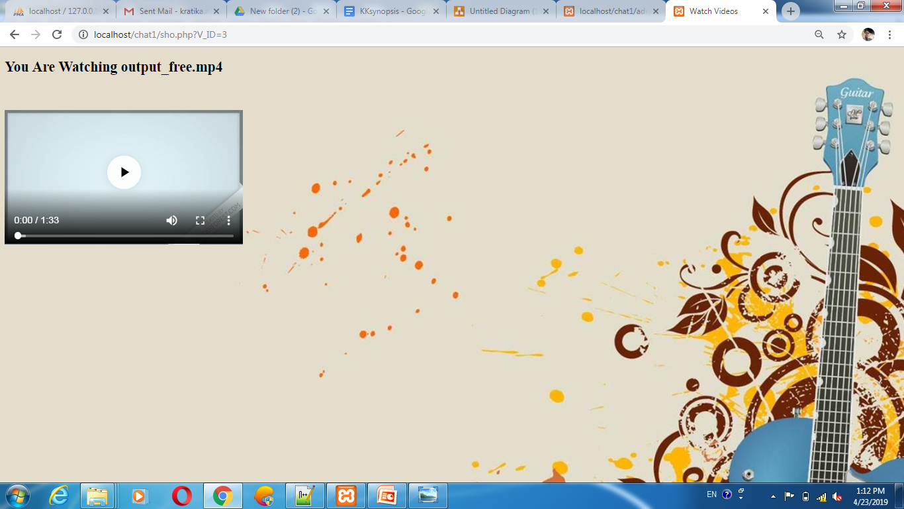

Slide 24
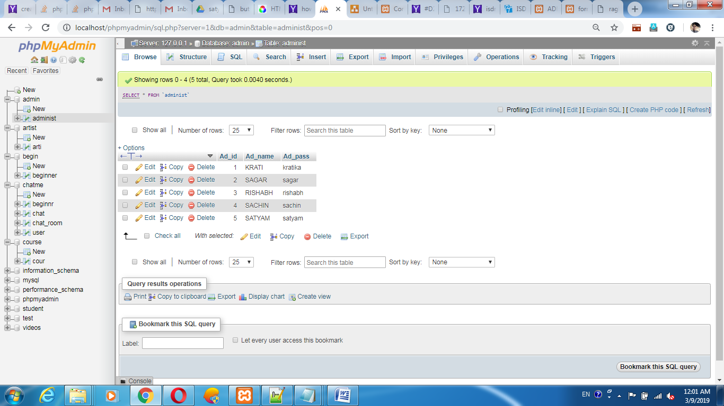
Databases

Slide 25
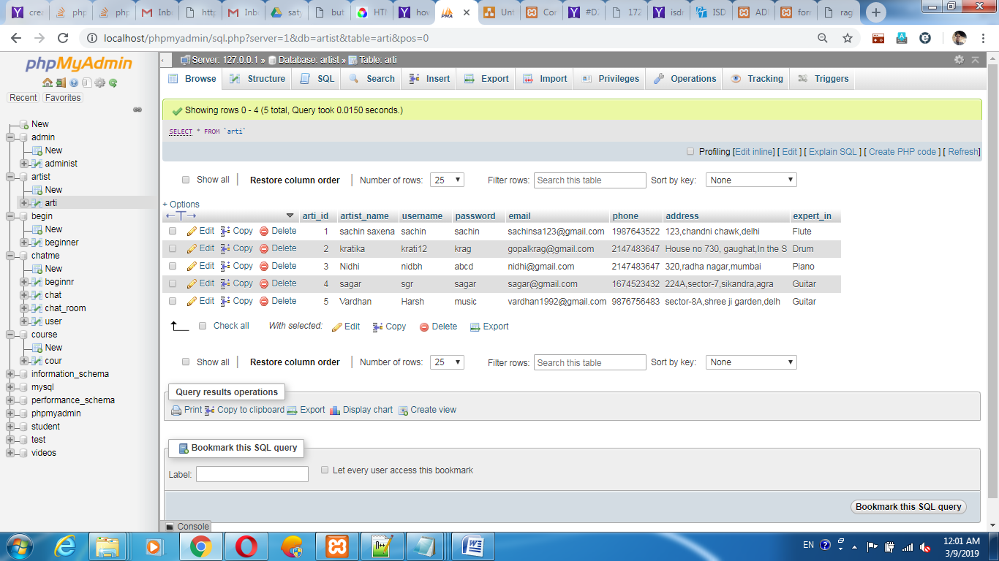

Slide 26
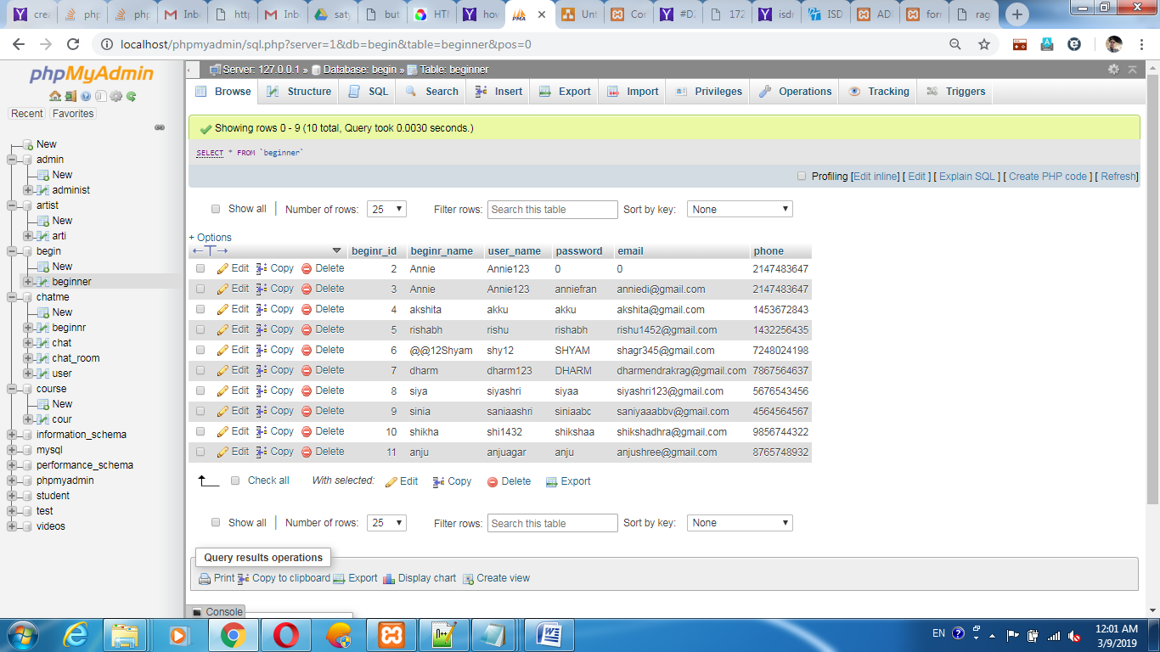

Slide 27
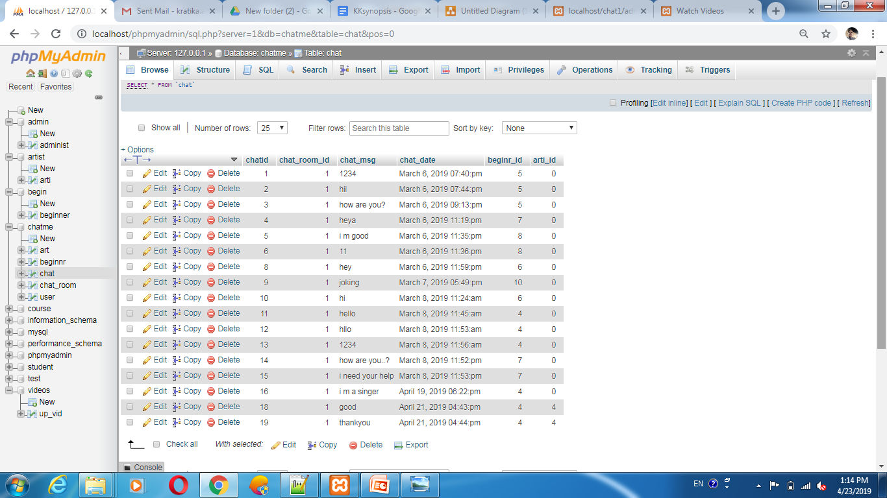

Slide 28
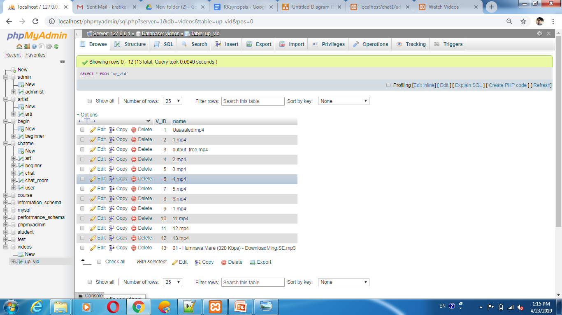

Slide 29
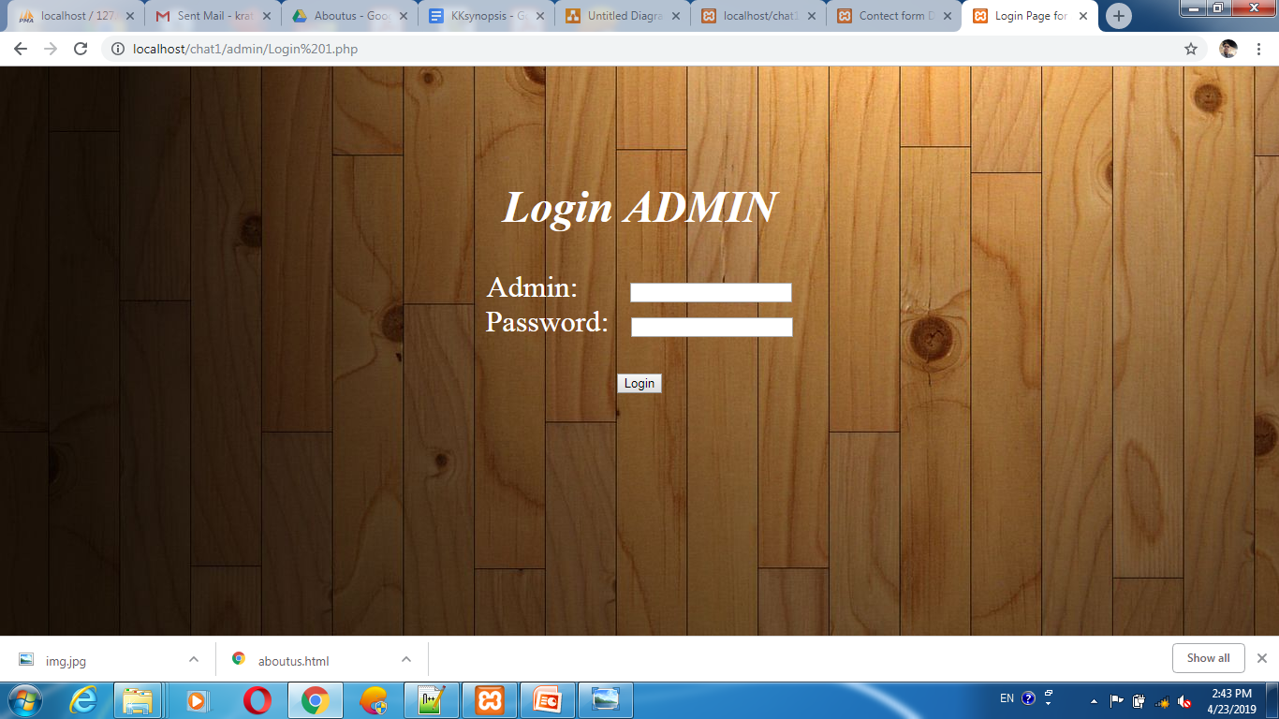
Admin Page

Slide 30
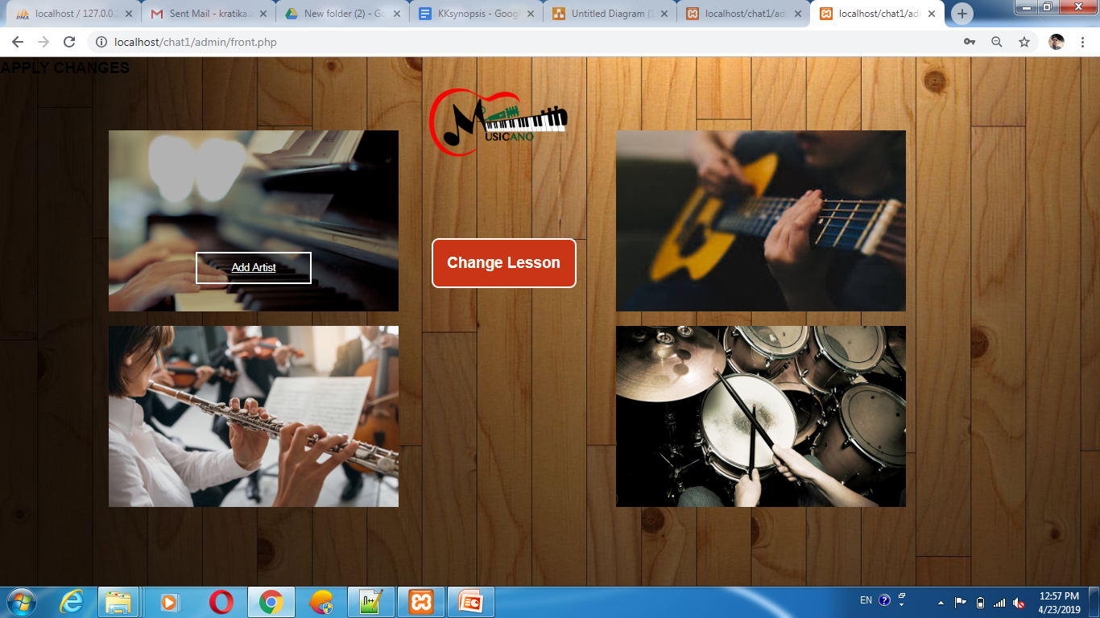

Slide 31
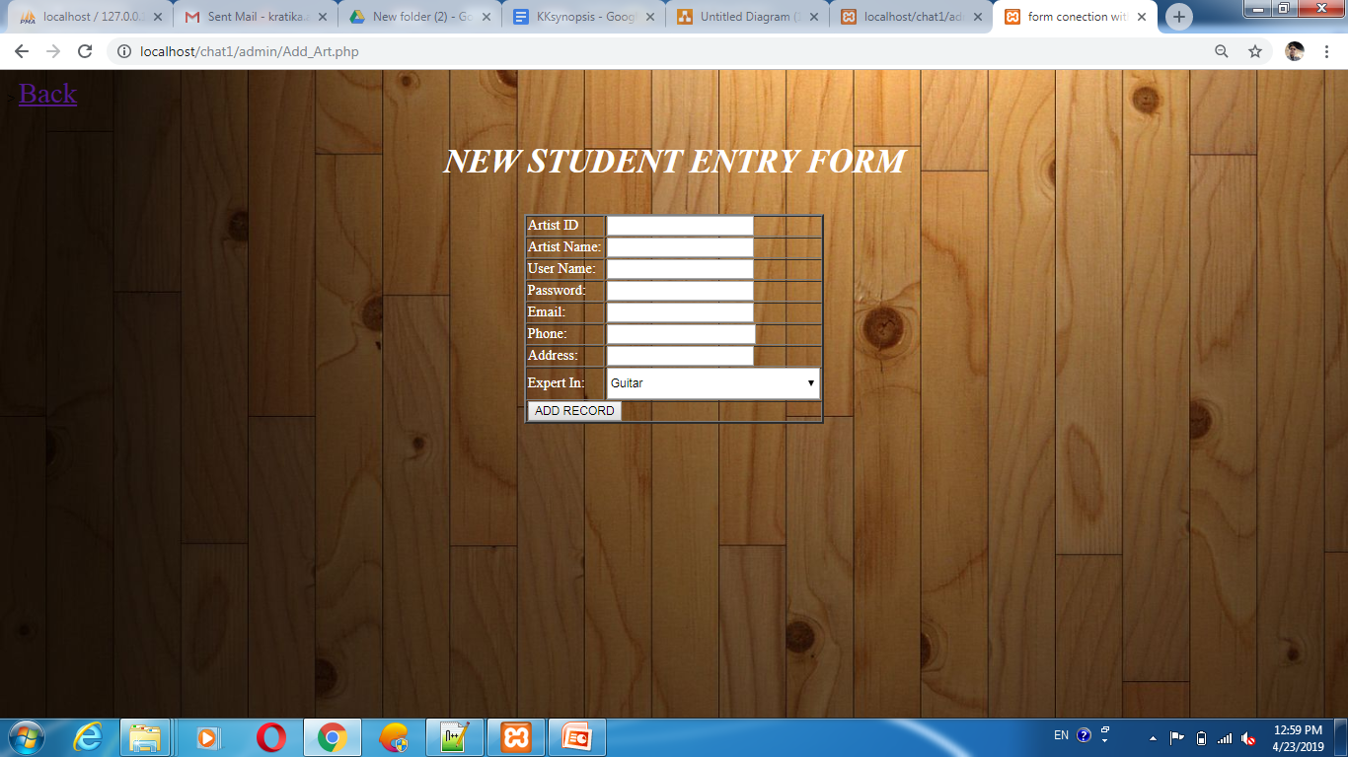

Slide 32
Conclusion
Reduce human effort
Can learn anytime, anywhere
Give the platform to rise
Easy to find different instrument expert

Slide 33

Thank You

